Slide 1
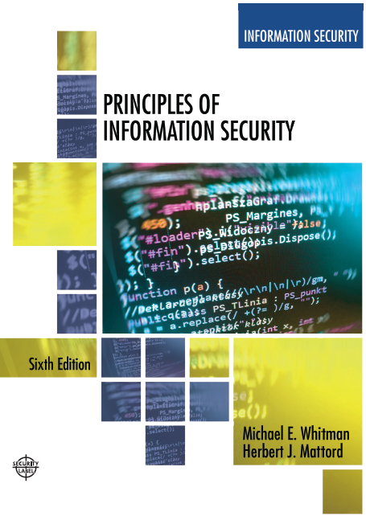

Principles of Information Security
Sixth Edition
Chapter1
Introduction to Information Security
Copyright © 2018 Cengage. May not be copied, scanned, or duplicated, in whole or in part, except for use as permitted in a license distributed with a certain product or service or otherwise on a password-protected website for classroom use.

Slide 2
The History of Information Security
Computer security began immediately after the first mainframes were developed
Groups developing code-breaking computations during World War II created the first modern computers.
Multiple levels of security were implemented.
Physical controls limiting access to sensitive military locations to authorized personnel
Rudimentary in defending against physical theft, espionage, and sabotage
Notes:
The History Of Information Security
Computer security began immediately after the first mainframes were developed
Groups developing code-breaking computations during World War II created the first modern computers
Multiple levels of security were implemented
Physical controls to limit access to sensitive military locations to authorized personnel
Rudimentary in defending against physical theft, espionage, and sabotage

Slide 3
Table 1-1 Key Dates in Information Security (1 of 2)
Date | Document
1968 | Maurice Wilkes discusses password security in Time - Sharing Computer Systems.
1970 | Willis H. Ware author the report Security Controls for Computer Systems: Report of Defense Science Board Task Force on Computer Security—RAND R.609 which was not declassified until 1979. I became known as the seminal work identifying the need for computer Security.
1973 | Schell, Downey, and Popek examine the need for additional security in military systems in Preliminary Notes on the Design of Secure Military Computer Systems.
1975 | The Federal Information Processing Standards (FIPS) examines DES (Digital Encryption Standard) In the Federal Register.
1978 | Bisbey and Hollingsworth publish their study “Protection Analysis: Final Report,” which discussed the Protection Analysis project created by ARPA to better understand the vulnerabilities of operating system security and examine the possibility of automated vulnerability detection techniques in existing system software.

Slide 4
Table 1-1 Key Dates in Information Security (2 of 2)
Date | Document
1979 | Dennis Ritchie publishes “On the Security of UNIX” and “Protection of Data File Contents,” which discussed secure user IDs, secure group IDs, and the problems inherent in the systems.
1982 | The US. Department of Defense Computer Security Evaluation Center publishes the first version of the Trusted Computer Security (TCSEC) documents, which came to be known as the Rainbow Series.
1982 | Grampp and Morris write “The UNIX System: UNIX Operating System Security.” In this report the authors examined four “important handles to computer security”: physical control of primes and computer facilities, management commitment to security objectives, education of employees, and administrative procedures aimed at increased security.
1984 | Reeds and Weinberger publish “File Security and the UNIX System Crypt Command.” Their premise was: “No technique can be secure against wiretapping or is equivalent on the computer. Therefore no technique can be secure against the system administrator or other privileged users... the naive user have no chance.”
1992 | Researchers for the Internet Engineering Task force, working at the Naval Research Laboratory, develop the Simple Internet Protocol Plus (SIPP) Security protocols, creating what is now known as IPSEC security.

Slide 5
The 1960s
Advanced Research Projects Agency (ARPA) began to examine the feasibility of redundant networked communications.
Larry Roberts developed the ARPANET from its inception.
Notes:
The 1960s
During the 1960s, the Department of Defense’s Advanced Research Procurement Agency (ARPA) began examining the feasibility of a redundant networked communications system designed to support the military’s need to exchange information.
Larry Roberts, known as the founder of the Internet, developed the project from its inception.

Slide 6
The 1970s and 80s (1 of 2)
ARPANET grew in popularity, as did its potential for misuse.
Fundamental problems with ARPANET security were identified.
No safety procedures for dial-up connections to ARPANET
Nonexistent user identification and authorization to system
Notes:
The 1970s and 80s
ARPANET grew in popularity as did its potential for misuse
Fundamental problems with ARPANET security were identified
No safety procedures for dial-up connections to ARPANET
Nonexistent user identification and authorization to system
Late 1970s: microprocessor expanded computing capabilities and security threats

Slide 7
The 1970s and 80s (2 of 2)
Information security began with RAND Report R-609 (paper that started the study of computer security and identified the role of management and policy issues in it)‏.
The scope of computer security grew from physical security to include:
Securing the data
Limiting random and unauthorized access to data
Involving personnel from multiple levels of the organization in information security
Notes:
The 1970s and 80s (cont’d.)
Information security began with Rand Report R-609 (paper that started the study of computer security and identified role of management and policy issues in it)‏
Scope of computer security grew from physical security to include:
Securing the data
Limiting random and unauthorized access to data
Involving personnel from multiple levels of the organization in information security

Slide 8
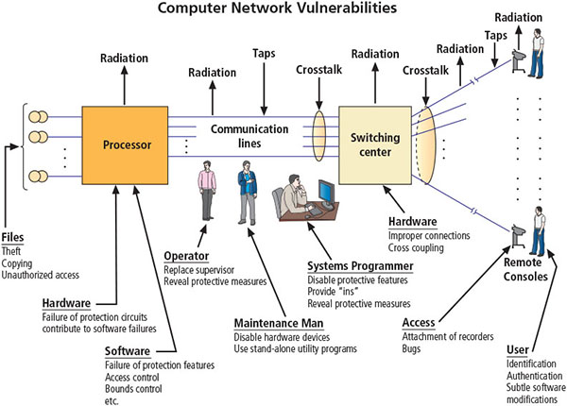
Figure 1-4 Illustration of computer network vulnerabilities from RAND Report R-609
Source. RAND Report R-609-1. Used with permission.

Slide 9
The 1990s
Networks of computers became more common, as did the need to connect them to each other.
Internet became the first global network of networks.
Initially, network connections were based on de facto standards.
In early Internet deployments, security was treated as a low priority.
In 1993, DEFCON conference was established for those interested in information security.
Notes:
The 1990s
Networks of computers became more common; so did the need to connect them to each other
Internet became first global network of networks
Initially based on de facto standards
In early Internet deployments, security was treated as a low priority
In 1993, DEFCON conference established for those interested in information security

Slide 10
2000 to Present
The Internet brings millions of unsecured computer networks into continuous communication with each other.
The ability to secure a computer’s data was influenced by the security of every computer to which it is connected.
Growing threat of cyber attacks has increased the awareness of need for improved security.
Nation-states engaging in information warfare
Notes:
2000 to Present
The Internet brings millions of unsecured computer networks into continuous communication with each other
Ability to secure a computer’s data influenced by the security of every computer to which it is connected
Growing threat of cyber attacks has increased the awareness of need for improved security
Nation-states engaging in information warfare

Slide 11
What Is Security? (1 of 2)
“A state of being secure and free from danger or harm; the actions taken to make someone or something secure.”
A successful organization should have multiple layers of security in place to protect:
Operations
Physical infrastructure
People
Functions
Communications
Information
Notes:
What Is Security?
“A state of being secure and free from danger or harm; the actions taken to make someone or something secure”
A successful organization should have multiple layers of security in place to protect:
Operations
Physical Infrastructure
People
Functions
Communications
Information

Slide 12
What Is Security? (2 of 2)
Information Security: The protection of information and its critical elements, including systems and hardware that use, store, and transmit that information (Committee on National Security Systems (CNSS))
Includes information security management, data security, and network security
C.I.A. triad
Is a standard based on confidentiality, integrity, and availability, now viewed as inadequate.
Expanded model consists of a list of critical characteristics of information.
Notes:
What Is Security? (cont’d.)
The protection of information and its critical elements, including systems and hardware that use, store, and transmit that information
Includes information security management, data security, and network security
C.I.A. triangle
Is standard based on confidentiality, integrity, and availability, now viewed as inadequate
Expanded model consists of a list of critical characteristics of information

Slide 13
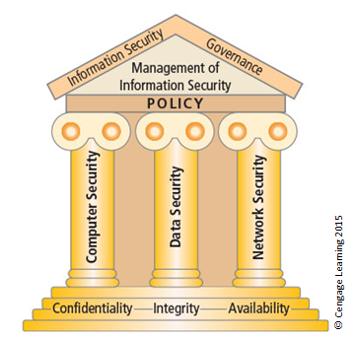
Figure 1-5 Components of information security (1 of 2)

Slide 14
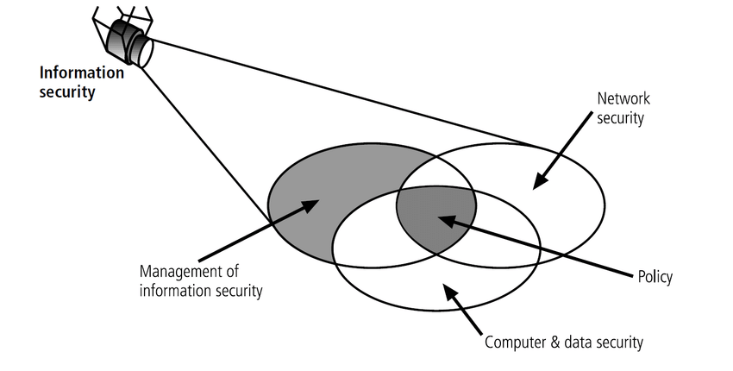
Figure 1-5 Components of information security (1 of 2)

Slide 15
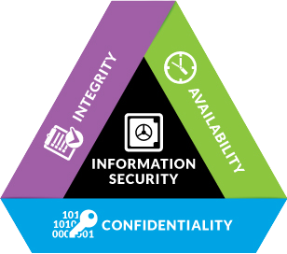
Figure 1-5 The C.I.A. triad (2 of 2)

Slide 16
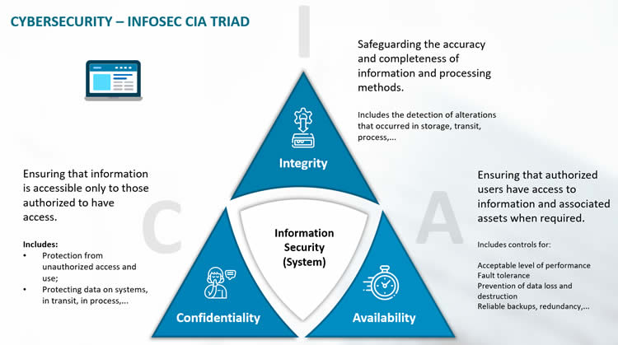

Slide 17
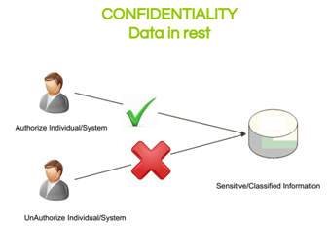
Security Triad CIA - Confidentiality

Slide 18
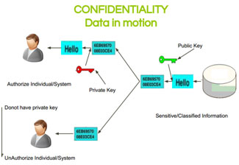
Security Triad CIA - Confidentiality

Slide 19
Confidentiality is Compromised?
Confidentiality can be compromised by:
Loss of a laptop containing data.
A person looking over our shoulder while we type a password.
An e-mail attachment being sent to the wrong person.
An attacker penetrating our systems, or similar issues.

Slide 20
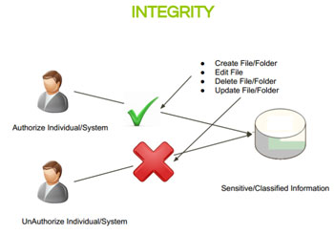
Security Triad CIA - Integrity

Slide 21
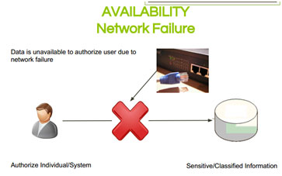
Security Triad CIA - Availability

Slide 22
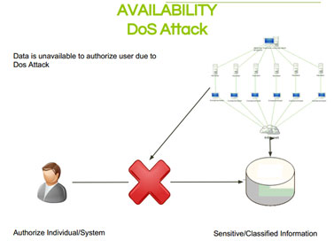
Security Triad CIA - Availability

Slide 23


Slide 24
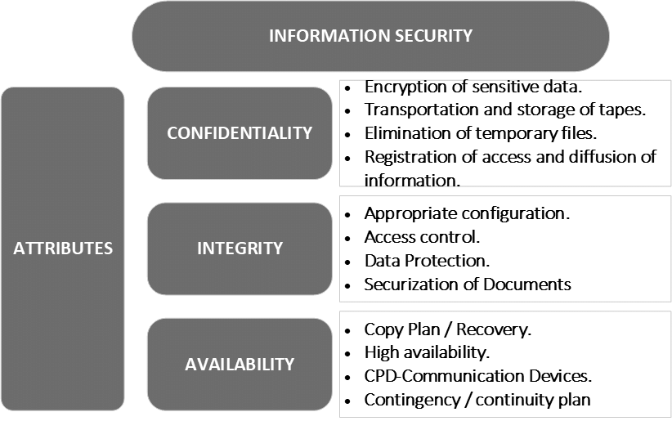
Achieving Pillars of Information Security

Slide 25
CIA triad examples
To understand how the CIA triad works in practice, consider the example of a bank ATM, which can offer users access to bank balances and other information. An ATM has tools that cover all three principles of the triad:
It provides confidentiality by requiring two-factor authentication (both a physical card and a PIN code) before allowing access to data
The ATM and bank software enforce data integrity by ensuring that any transfers or withdrawals made via the machine are reflected in the accounting for the user's bank account
The machine provides availability because it's in a public place and is accessible even when the bank branch is closed

Slide 26
Authenticity and Accountability
Although the use of CIA to define the security objectives is a well established, additional security concepts is needed to present Authenticity and Accountability
Authenticity: The property of being able to be verified and trusted. This means verifying that users are who they say and that each input arriving at the system came from trusted source.
Accountability: The security goal that generates the requirement for actions of an entity to be traced uniquely to the entity.

Slide 27
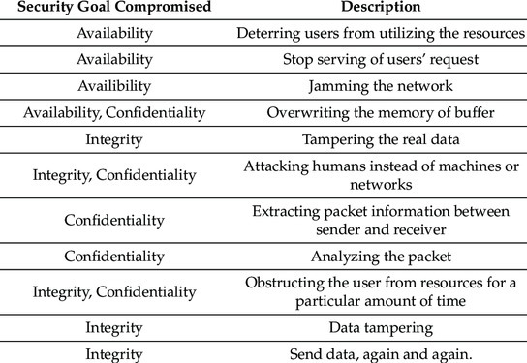
Security Triad CIA - Availability

Slide 28
Security Triad CIA - Availability

Slide 29
CIA Triad Exercise Problems
Classify each of the following as a violation of confidentiality, of integrity, of availability, or of some combination thereof.
Asma copies Safa’s homework.
Copying a data is a violation of confidentiality
CONFIDENTIALITY
Abdullah crashes Yasin’s system.
This crashing causes unavailability of the system to Abdullah.
Availability, integrity

Slide 30
CIA Triad Exercise Problems
CIA Triad Exercise Problems
Sabriyya changes the amount of Jaleela’s check from $100 to $1,000.
The data on the check got changed which is a data integrity violation.
data integrity
Zainab forges Zahra’s signature on a deed.
Zainab forged the signature of Zahra. The deed appears is coming from Zahra which is not true and hence it is related to source integrity.
integrity

Slide 31
CIA Triad Exercise Problems
Khamis registers the domain name “AddisonWesley.com” and refuses to let the publishing house buy or use that domain name.
The name of the website will not be available to the publishers to buy and it is violation of availability. The users of the website may believe that Khamis’s website is the legitimate site and it is violation of Integrity.
Availability

Slide 32
CIA Triad Exercise Problems
Bashair obtains Sausan’s credit card number and has the credit card company cancel the card and replace it with another card bearing a different account number.

Slide 33
Bashair obtained the credit card of Susan and caused for the cancellation. Here the credit card information has been used without any authorization and hence it is related to confidentiality. The card number got changed due to the false representation of Bashair and hence it is a violation of integrity in specific Source Integrity. Due to this Susan will no longer able to use his credit card and it is violation of availability.
confidentiality, integrity, availability
CIA Triad Exercise Problems

Slide 34
CIA Triad Exercise Problems
CIA Triad Exercise Problems
Khalid spoofs Ibrahim’s IP address to gain access to his computer.
Khalid’s message appears coming from Ibrahim’s IP address which is not true. So it is a violation of Integrity in specific source integrity. By doing this Khalid can access the data of Ibrahim and it is the violation of Confidentiality.
integrity

Slide 35
The Security Trinity
The three legs of the "security trinity“ are:
Prevention
Detection
Response
The security trinity should be the foundation for all security policies and measures that an organization develops and deploys.
Prevention
Response
Detection

Slide 36
The Security Trinity - Prevention
To provide some level of security, it is necessary to implement measures to prevent the exploitation of vulnerabilities.
It is easier, more efficient, and much more cost-effective to prevent a security breach than to detect or respond to one.
Prevention
Response
Detection

Slide 37
The Security Trinity - Detection
Once preventative measures are implemented, procedures need to be put in place to detect security breaches, in the event preventative measures fail.
It is very important to detect problems immediately. The sooner a problem is detected the easier it is to correct and clean-up.
Prevention
Response
Detection

Slide 38
The Security Trinity - Response
Organizations need to develop a plan that identifies the appropriate response to a security breach.
The plan should be in writing and should identify who is responsible for what actions.
Prevention
Response
Detection

Slide 39
Key Information Security Concepts (1 of 3)
Access - a subject or object’s ability to use, manipulate, modify, or affect another subject or object.
Asset - the organizational resource that is being protected.
Attack - an intentional or unintentional act that can damage or otherwise compromise information and the systems that support it.
Control, Safeguard, or Countermeasure - Security mechanisms, policies, or procedures that can successfully counter attacks, reduce risk, resolve vulnerabilities, and otherwise improve security within an organization.

Slide 40
Key Information Security Concepts (2 of 3)
Exploit – a technique used to compromise a system.
Exposure - a condition or state of being exposed.
Loss: A single instance of an information asset suffering damage or destruction, unintended or unauthorized modification or disclosure, or denial of use.
Protection Profile or Security Posture-entire set of controls and safeguards that the organization implements to protect the asset.

Slide 41
Key Information Security Concepts (3 of 3)
Protection Profile or Security Posture-entire set of controls and safeguards that the organization implements to protect the asset.
Risk - the probability of an unwanted occurrence.
Subjects and Objects – a computer can be either an agent entity used to conduct an attack, or the target entity.
Threat - a category of objects, people, or other entities that represents a danger to an asset.
Threat Agent – the specific instance or a component of a threat.
Vulnerability - weaknesses or faults in a system or protection mechanism that expose information to attack or damage.

Slide 42
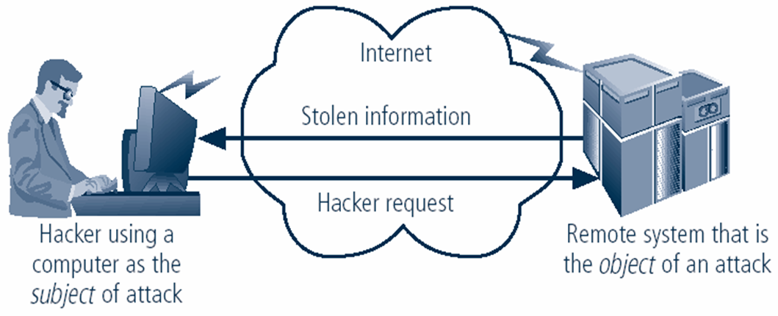
Computer as subject of an attack and/or the object of an attack
When it is the subject of an attack, the computer is used as an active tool to conduct attack.
When it is the object of an attack, the computer is the entity being attacked.
Notes:
Key Information Security Concepts
When considering the security of information systems components, it is important to understand the concept of the computer as the subject of an attack as opposed to the computer as the object of an attack.
When a computer is the subject of an attack, it is used as an active tool to conduct the attack. When a computer is the object of an attack, it is the entity being attacked.

Slide 43
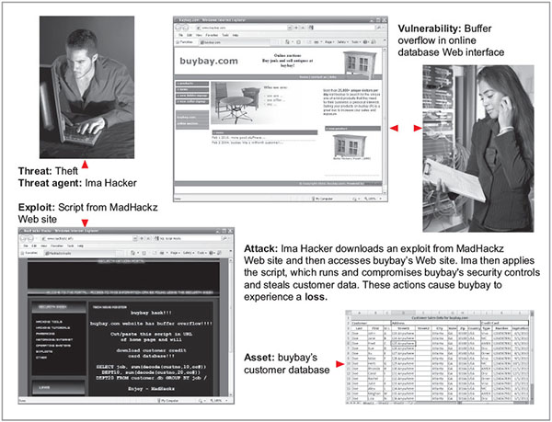
Figure 1-7 Key concepts in information security
Source. (top left to bottom right): © iStockphoto/tadija, Internet Explorer, © iStockphoto/darrenwise , Internet Explorer, Microsoft Excel.

Slide 44
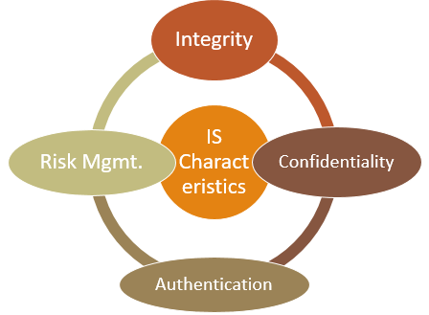
Critical Characteristics of Information
The value of information comes from the characteristics it possesses:
Availability
Accuracy
Authenticity
Confidentiality
Integrity
Utility (usefulness)
Possession (control)
Notes:
Critical Characteristics of Information
The value of information comes from the characteristics it possesses.
Availability – Enables users who need to access information to do so without interference or obstruction and in the required format. The information is said to be available to an authorized user when and where needed and in the correct format.
Accuracy – Free from mistake or error and having the value that the end user expects. If information contains a value different from the user’s expectations due to the intentional or unintentional modification of its content, it is no longer accurate.
Authenticity –The quality or state of being genuine or original, rather than a reproduction or fabrication. Information is authentic when it is the information that was originally created, placed, stored, or transferred.
Confidentiality – The quality or state of preventing disclosure or exposure to unauthorized individuals or systems.
Integrity – The quality or state of being whole, complete, and uncorrupted. The integrity of information is threatened when the information is exposed to corruption, damage, destruction, or other disruption of its authentic state.
Utility – The quality or state of having value for some purpose or end. Information has value when it serves a particular purpose. This means that if information is available, but not in a format meaningful to the end user, it is not useful.
Possession – The quality or state of having ownership or control of some object or item. Information is said to be in possession if one obtains it, independent of format or other characteristic. While a breach of confidentiality always results in a breach of possession, a breach of possession does not always result in a breach of confidentiality.

Slide 45
Critical Characteristics of Information
The value of information comes from the characteristics it possesses:
Availability
Enables authorized users or computers to access information without interference or obstruction and to receive it in the required format
Accuracy
Accuracy : When it is free from mistakes or errors and it has the value that user expects [Bank Balance]
Authenticity
The Quality or State of being genuine or Original, rather than a Reproduction or Fabrication [Email spoofing]
Confidentiality
Prevented from the disclosure or exposure to unauthorized individuals or systems [bits & pieces of info / Salami theft]
Notes:
Critical Characteristics of Information
The value of information comes from the characteristics it possesses.
Availability – Enables users who need to access information to do so without interference or obstruction and in the required format. The information is said to be available to an authorized user when and where needed and in the correct format.
Accuracy – Free from mistake or error and having the value that the end user expects. If information contains a value different from the user’s expectations due to the intentional or unintentional modification of its content, it is no longer accurate.
Authenticity –The quality or state of being genuine or original, rather than a reproduction or fabrication. Information is authentic when it is the information that was originally created, placed, stored, or transferred.
Confidentiality – The quality or state of preventing disclosure or exposure to unauthorized individuals or systems.
Integrity – The quality or state of being whole, complete, and uncorrupted. The integrity of information is threatened when the information is exposed to corruption, damage, destruction, or other disruption of its authentic state.
Utility – The quality or state of having value for some purpose or end. Information has value when it serves a particular purpose. This means that if information is available, but not in a format meaningful to the end user, it is not useful.
Possession – The quality or state of having ownership or control of some object or item. Information is said to be in possession if one obtains it, independent of format or other characteristic. While a breach of confidentiality always results in a breach of possession, a breach of possession does not always result in a breach of confidentiality.

Slide 46
Critical Characteristics of Information (Contd…)
The value of information comes from the characteristics it possesses:
Integrity
It is Whole, complete and uncorrupted [file hashing]
Utility
The quality or state of having value for some purpose or end
Possession
The quality or state of having ownership or control of some object or item
Notes:
Critical Characteristics of Information
The value of information comes from the characteristics it possesses.
Availability – Enables users who need to access information to do so without interference or obstruction and in the required format. The information is said to be available to an authorized user when and where needed and in the correct format.
Accuracy – Free from mistake or error and having the value that the end user expects. If information contains a value different from the user’s expectations due to the intentional or unintentional modification of its content, it is no longer accurate.
Authenticity –The quality or state of being genuine or original, rather than a reproduction or fabrication. Information is authentic when it is the information that was originally created, placed, stored, or transferred.
Confidentiality – The quality or state of preventing disclosure or exposure to unauthorized individuals or systems.
Integrity – The quality or state of being whole, complete, and uncorrupted. The integrity of information is threatened when the information is exposed to corruption, damage, destruction, or other disruption of its authentic state.
Utility – The quality or state of having value for some purpose or end. Information has value when it serves a particular purpose. This means that if information is available, but not in a format meaningful to the end user, it is not useful.
Possession – The quality or state of having ownership or control of some object or item. Information is said to be in possession if one obtains it, independent of format or other characteristic. While a breach of confidentiality always results in a breach of possession, a breach of possession does not always result in a breach of confidentiality.

Slide 47
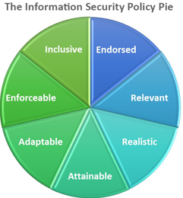
Characteristics of IS Policy
Endorsed – The policy has the support of management.
Relevant - The policy is applicable to the organization
Realistic – The policy makes sense
Attainable – The policy can be successfully implemented
Adaptable – The policy can accommodate change
Enforceable – The policy is statutory.
Inclusive – The policy scope includes all relevant parties.
Notes:
Critical Characteristics of Information
The value of information comes from the characteristics it possesses.
Availability – Enables users who need to access information to do so without interference or obstruction and in the required format. The information is said to be available to an authorized user when and where needed and in the correct format.
Accuracy – Free from mistake or error and having the value that the end user expects. If information contains a value different from the user’s expectations due to the intentional or unintentional modification of its content, it is no longer accurate.
Authenticity –The quality or state of being genuine or original, rather than a reproduction or fabrication. Information is authentic when it is the information that was originally created, placed, stored, or transferred.
Confidentiality – The quality or state of preventing disclosure or exposure to unauthorized individuals or systems.
Integrity – The quality or state of being whole, complete, and uncorrupted. The integrity of information is threatened when the information is exposed to corruption, damage, destruction, or other disruption of its authentic state.
Utility – The quality or state of having value for some purpose or end. Information has value when it serves a particular purpose. This means that if information is available, but not in a format meaningful to the end user, it is not useful.
Possession – The quality or state of having ownership or control of some object or item. Information is said to be in possession if one obtains it, independent of format or other characteristic. While a breach of confidentiality always results in a breach of possession, a breach of possession does not always result in a breach of confidentiality.

Slide 48
NSTISSC Security Model
National Security Telecommunications, and Information Systems Security Committee (NSTISSC)
Model for Information Security and is becoming Evaluation Standard
27 Cells representing areas that must be addressed in the security process
Notes:
This graphic informs the fundamental approach of the chapter and can be used to illustrate the intersection of information states (x-axis), key objectives of C.I.A. (y-axis), and the three primary means to implement (policy, education, and technology).

Slide 49
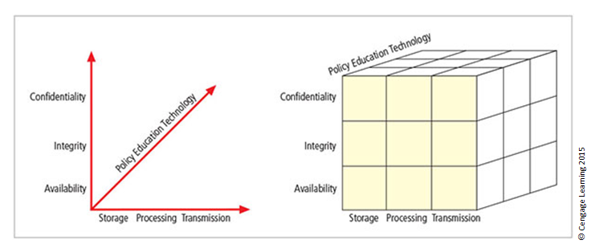
Figure 1-9 The McCumber Cube
Intersection of information states (x-axis)
Key objectives of C.I.A. (y-axis), and
Three primary means to implement (policy, education and technology).
Notes:
This graphic informs the fundamental approach of the chapter and can be used to illustrate the intersection of information states (x-axis), key objectives of C.I.A. (y-axis), and the three primary means to implement (policy, education, and technology).

Slide 50
The McCumber Cube - Explained
Intersection between Technology, Integrity, and Storage
control or safeguard that addresses the need to use technology to protect the integrity of information while in storage.
Control - A system for detecting host intrusion that protects the integrity of information by alerting the security administrators to the potential modification of critical files.
Notes:
This graphic informs the fundamental approach of the chapter and can be used to illustrate the intersection of information states (x-axis), key objectives of C.I.A. (y-axis), and the three primary means to implement (policy, education, and technology).

Slide 51
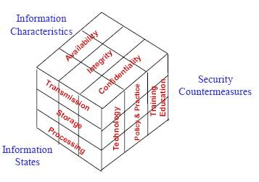
McCumber INFOSEC Model
Notes:
This graphic informs the fundamental approach of the chapter and can be used to illustrate the intersection of information states (x-axis), key objectives of C.I.A. (y-axis), and the three primary means to implement (policy, education, and technology).

Slide 52
McCumber INFOSEC Model Information Characteristics
Information characteristics refers to the attributes of information that are important to consider when designing security measures.
These characteristics include confidentiality, integrity, availability, authenticity, and utility.
Confidentiality refers to the protection of information from unauthorized disclosure
Integrity refers to the protection of information from unauthorized modification
Notes:
This graphic informs the fundamental approach of the chapter and can be used to illustrate the intersection of information states (x-axis), key objectives of C.I.A. (y-axis), and the three primary means to implement (policy, education, and technology).

Slide 53
McCumber INFOSEC Model Information Characteristics
Availability refers to the protection of information from unauthorized destruction or denial of access,
Authenticity refers to the assurance that information is genuine and originated from a trusted source,
Utility refers to the usefulness of information for its intended purpose.
Notes:
This graphic informs the fundamental approach of the chapter and can be used to illustrate the intersection of information states (x-axis), key objectives of C.I.A. (y-axis), and the three primary means to implement (policy, education, and technology).

Slide 54
McCumber INFOSEC Model Information States
Information states refer to the different stages of information processing where security risks and vulnerabilities can arise.
These states include data at rest, data in transit, and data in use.
Data at rest refers to information that is stored in a system
Data in transit refers to information that is being transmitted between systems,
Data in use refers to information that is actively being accessed and processed.
Notes:
This graphic informs the fundamental approach of the chapter and can be used to illustrate the intersection of information states (x-axis), key objectives of C.I.A. (y-axis), and the three primary means to implement (policy, education, and technology).

Slide 55
McCumber INFOSEC Model Security Countermeasures
Security countermeasures are the actions or technologies used to protect information from security risks and vulnerabilities.
Countermeasures include technical, administrative, and physical controls, such as encryption, access control, backup and recovery, intrusion detection and prevention, security policies and procedures, and security awareness training.
Notes:
This graphic informs the fundamental approach of the chapter and can be used to illustrate the intersection of information states (x-axis), key objectives of C.I.A. (y-axis), and the three primary means to implement (policy, education, and technology).

Slide 56
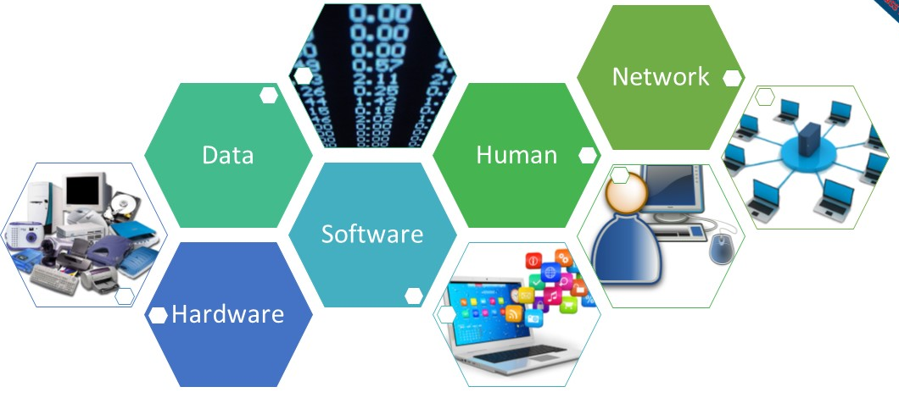
Components of an Information System
Information system (IS) is the entire set of people, procedures, and technology that enable business to use information.
Procedure
Notes:
Components of an Information System
Information system (IS) is entire set of people, procedures, and technology that enable business to use information.
Software: The software component of an IS includes applications (programs), operating systems, and assorted command utilities. Software is perhaps the most difficult IS component to secure
Hardware: Physical security policies deal with hardware as a physical asset and with the protection of physical assets from harm or theft.
Data: Data stored, processed, and transmitted by a computer system must be protected. Data is often the most valuable asset of an organization and therefore is the main target of inten- tional attacks.
People: Though often overlooked in computer security considerations, people have always been a threat to information security.
Procedures: Procedures are another frequently overlooked component of an IS. Procedures are written instructions for accomplishing a specific task.
Networks: Networking is the IS component that created much of the need for increased computer and information security.

Slide 57
Components of an Information System
Software
Components of IS comprises applications, operating systems, and assorted command utilities.
Software programs are the vessels that carry the lifeblood of information through an organization
Hardware
The physical technology that houses and executes the software, stores and carries the data, and provides interfaces for the entry and removal of information from the system.
Notes:
Components of an Information System
Information system (IS) is entire set of people, procedures, and technology that enable business to use information.
Software: The software component of an IS includes applications (programs), operating systems, and assorted command utilities. Software is perhaps the most difficult IS component to secure
Hardware: Physical security policies deal with hardware as a physical asset and with the protection of physical assets from harm or theft.
Data: Data stored, processed, and transmitted by a computer system must be protected. Data is often the most valuable asset of an organization and therefore is the main target of inten- tional attacks.
People: Though often overlooked in computer security considerations, people have always been a threat to information security.
Procedures: Procedures are another frequently overlooked component of an IS. Procedures are written instructions for accomplishing a specific task.
Networks: Networking is the IS component that created much of the need for increased computer and information security.

Slide 58
Components of an Information System
Data
Data stored, processed, and transmitted through a computer system must be protected.
Data is often the most valuable asset possessed by an organization and is the main target of intentional attacks
People
There are many roles for people in information systems.
Systems Analyst
Programmer
Technician
Engineer
Network Manager
MIS ( Manager of Information Systems )
Data entry operator
Notes:
Components of an Information System
Information system (IS) is entire set of people, procedures, and technology that enable business to use information.
Software: The software component of an IS includes applications (programs), operating systems, and assorted command utilities. Software is perhaps the most difficult IS component to secure
Hardware: Physical security policies deal with hardware as a physical asset and with the protection of physical assets from harm or theft.
Data: Data stored, processed, and transmitted by a computer system must be protected. Data is often the most valuable asset of an organization and therefore is the main target of inten- tional attacks.
People: Though often overlooked in computer security considerations, people have always been a threat to information security.
Procedures: Procedures are another frequently overlooked component of an IS. Procedures are written instructions for accomplishing a specific task.
Networks: Networking is the IS component that created much of the need for increased computer and information security.

Slide 59
Components of an Information System
Procedures
A procedure is a series of documented actions taken to achieve something.
A procedure is more than a single simple task.
A procedure can be quite complex and involved, such as performing a backup, shutting down a system, patching software.
Networks
Information systems are connected to each other to form Local Area Network (LANs), and these LANs are connected to other networks such as the Internet, new security challenges rapidly emerge.
Steps to provide network security are essential, as is the implementation of alarm and intrusion systems to make system owners aware of ongoing compromises.
Notes:
Components of an Information System
Information system (IS) is entire set of people, procedures, and technology that enable business to use information.
Software: The software component of an IS includes applications (programs), operating systems, and assorted command utilities. Software is perhaps the most difficult IS component to secure
Hardware: Physical security policies deal with hardware as a physical asset and with the protection of physical assets from harm or theft.
Data: Data stored, processed, and transmitted by a computer system must be protected. Data is often the most valuable asset of an organization and therefore is the main target of inten- tional attacks.
People: Though often overlooked in computer security considerations, people have always been a threat to information security.
Procedures: Procedures are another frequently overlooked component of an IS. Procedures are written instructions for accomplishing a specific task.
Networks: Networking is the IS component that created much of the need for increased computer and information security.

Slide 60
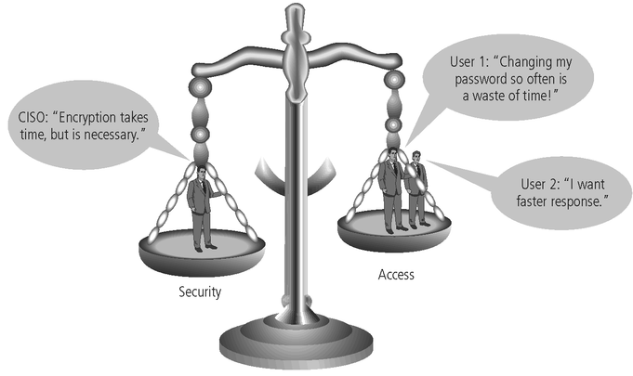
Balancing Information Security and Access
Impossible to obtain perfect information security—it is a process, not a goal.
Security should be considered a balance between protection and availability.
To achieve balance, the level of security must allow reasonable access, yet protect against threats.
Notes:
Security and Access Balancing
When considering information security, it is important to realize that it is impossible to obtain perfect security. Security is not an absolute; it is a process not a goal.
Security should be considered a balance between protection and availability.
To achieve balance, the level of security must allow reasonable access yet protect against threats.

Slide 61
Approaches to Information Security Implementation: Bottom-Up Approach
Grassroots effort: Systems administrators attempt to improve security of their systems.
Key advantage: technical expertise of individual administrators
Seldom works, as it lacks a number of critical features:
Participant support
Organizational staying power
Notes:
Bottom-up Approach to Security Implementation
Security can begin as a grass-roots effort when systems administrators attempt to improve the security of their systems. This is referred to as the bottom-up approach.
The key advantage of the bottom-up approach is the technical expertise of the individual administrators.
Unfortunately, this approach seldom works, as it lacks a number of critical features, such as participant support and organizational staying power.

Slide 62
Approaches to Information Security Implementation: Top-Down Approach
Initiated by upper management
Issue policy, procedures, and processes
Dictate goals and expected outcomes of project
Determine accountability for each required action
The most successful type of top-down approach also involves a formal development strategy referred to as systems development life cycle.
Notes:
Top-down Approach to Security Implementation
An alternative approach, which has a higher probability of success, is called the top-down approach. The project is initiated by upper management who issue policy, procedures, and processes; dictate the goals and expected outcomes of the project; and determine who is accountable for each of the required actions.
The top-down approach has strong upper-management support, a dedicated champion, dedicated funding, clear planning, and the opportunity to influence organizational culture.
The most successful top-down approach also involves a formal development strategy referred to as a systems development life cycle.

Slide 63
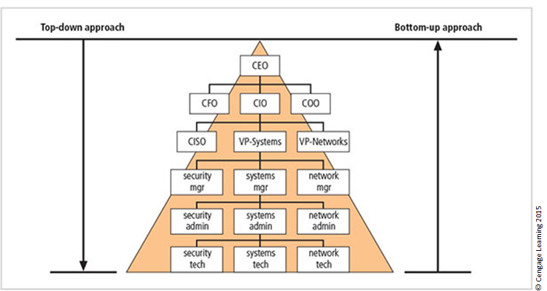
Figure 1-12 Approaches to information security implementation
Notes:
The key concept here is the direction of the left and right side arrows to show where planning is sourced and from which direction the pressure for success is driven.

Slide 64
Security in the Systems Development Life Cycle
Systems development life cycle (SDLC): a methodology for the design and implementation of an information system
Methodology: a formal approach to solving a problem based on a structured sequence of procedures
Using a methodology:
Ensures a rigorous process with a clearly defined goal
Increases probability of success
Notes:
The Systems Development Life Cycle
Systems Development Life Cycle (SDLC): methodology for design and implementation of an information system
Methodology: formal approach to solving a problem based on a structured sequence of procedures
Using a methodology:
Ensures a rigorous process with a clearly defined goal
Increases probability of success
Traditional SDLC consists of six general phases

Slide 65
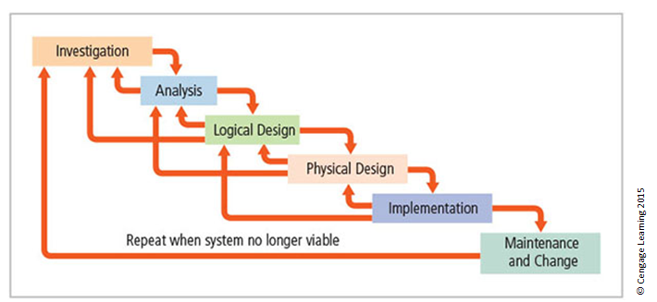
Figure 1-13 SDLC waterfall methodology
Notes:
Very much a traditional SDLC diagram.

Slide 66
SDLC Group Exercise:
Divide into groups and develop systems requirements for making an automated peanut butter and jam sandwich machine.
Notes:
Very much a traditional SDLC diagram.

Slide 67
SDLC Group Exercise: Divide the students into groups and challenge them to develop systems requirements for making an automated peanut butter and jam sandwich machine.
The steps taken to make a peanut butter and jam sandwich will vary by each individual. The purpose of this exercise is to demonstrate that gathering requirements is incredibly difficult because everyone does a job different with different inputs. This appears to be a very easy task but in order to automate this process everyone in the group must agree on the ingredients and the order the ingredients are applied.
Potential ingredients:
Type of bread: white, wheat, rye, pumpernickel
Butter applied (optional)
Type of peanut butter: chunky, smooth
Type of jam: strawberry, raspberry, marmalade
Sandwich sliced: in half, in quarters, whole
Potential process:
Place one slice of bread on machine, spread the peanut butter, spread the jam, place the second slice of bread
Place both slices of bread on machine, spread the jam on one slice, spread the peanut butter on another slice, fold bread together
Place one slice of bread on machine, spread the peanut butter and jam at the same time, place the second piece of bread on machine, spread the peanut butter and jam on second slice, fold slices together.
Notes:
Very much a traditional SDLC diagram.

Slide 68
Security in SDLC - Investigation
What problem is the system being developed to solve?
Objectives, constraints and scope of project are specified
Preliminary cost-benefit analysis is developed
At the end, feasibility analysis is performed to assesses economic, technical, and behavioral feasibilities of the process
Notes:
Investigation
The first phase, investigation, is the most important.
What is the problem the system is being developed to solve?
This phase begins with an examination of the event or plan that initiates the process.
The objectives, constraints and scope of the project are specified. A preliminary cost/benefit analysis is developed to evaluate the perceived benefits and the appropriate levels of cost an organization is willing to expend to obtain those benefits.
A feasibility analysis is performed to assesses the economic, technical, and behavioral feasibilities of the process and to ensure that implementation is worth the organization’s time and effort.

Slide 69
Security in SDLC - Analysis
Consists of assessments of the organization, status of current systems, and capability to support proposed systems
Analysts determine what new system is expected to do and how it will interact with existing systems
Ends with documentation of findings and update of feasibility analysis
Notes:
Analysis
The analysis phase begins with the information learned during the investigation phase.
This phase consists primarily of assessments of the organization, the status of current systems, and the capability to support the proposed systems.
Analysts begin to determine what the new system is expected to do, and how it will interact with existing systems.
This phase ends with the documentation of the findings and a feasibility analysis update.

Slide 70
Security in SDLC - Logical Design
Main factor is business need; applications capable of providing needed services are selected
Data support and structures capable of providing the needed inputs are identified
Technologies to implement physical solution are determined
Feasibility analysis performed at the end
Notes:
Logical Design
In the logical design phase, the information gained from the analysis phase is used to begin creating a solution system for a business problem.
Then, based on the business need, select applications capable of providing needed services.
Based on the applications needed, select data support and structures capable of providing the needed inputs.
Finally, based on all of the above, select specific technologies to implement the physical solution.
In the end, another feasibility analysis is performed.

Slide 71
Security in SDLC - Physical Design
Technologies to support the alternatives identified and evaluated in the logical design are selected
Components evaluated on make-or-buy decision
Feasibility analysis performed; entire solution presented to end-user representatives for approval
Notes:
Physical Design
During the physical design phase, specific technologies are selected to support the alternatives identified and evaluated in the logical design.
The selected components are evaluated based on a make-or-buy decision (develop in-house or purchase from a vendor).
Final designs integrate various components and technologies.
After yet another feasibility analysis, the entire solution is presented to the end-user representatives for approval.

Slide 72
Security in SDLC - Implementation
Needed software created; components ordered, received, assembled, and tested
Users trained and documentation created
Feasibility analysis prepared; users presented with system for performance review and acceptance test
Notes:
Implementation
In the implementation phase, any needed software is created or purchased
Components are ordered, received and tested.
Afterwards, users are trained and supporting documentation created.
Again a feasibility analysis is prepared, and the users are then presented with the system for a performance review and acceptance test.

Slide 73
Security in SDLC - Maintenance and Change
Consists of tasks necessary to support and modify system for remainder of its useful life
Life cycle continues until the process begins again from the investigation phase
When current system can no longer support the organization’s mission, a new project is implemented
Notes:
Maintenance and Change
The maintenance and change phase is the longest and most expensive phase of the process.
This phase consists of the tasks necessary to support and modify the system for the remainder of its useful life cycle.
Even though formal development may conclude during this phase, the life cycle of the project continues until it is determined that the process should begin again from the investigation phase. When the current system can no longer support the changed mission of the organization, the project is terminated and a new project is implemented.

Slide 74
The Security Systems Development Life Cycle (SecSDLC)
An SecSDLC is a methodology for the design and implementation of an information system
SecSDLC-based projects may be initiated by events or planned
SecSDLC is a coherent program rather than a series of random, seemingly unconnected actions
At the end of each phase, a review occurs when reviewers determine if the project should be continued, discontinued, outsourced, or postponed
Identification of specific threats and creating controls to counter them
Notes:
The Security Systems Development Life Cycle
The same phases used in the traditional SDLC can be adapted to support the specialized implementation of a security project.
The fundamental process is the identification of specific threats and the creation of specific controls to counter those threats.
The SecSDLC unifies the process and makes it a coherent program rather than a series of random, seemingly unconnected actions.

Slide 75
The Security Systems Development Life Cycle (SecSDLC)
The SecSDLC process involves the identification of specific threats and the risks that they represent as well as the subsequent design and implementation of specific controls to counter those threats and manage the risk
Notes:
The Security Systems Development Life Cycle
The same phases used in the traditional SDLC can be adapted to support the specialized implementation of a security project.
The fundamental process is the identification of specific threats and the creation of specific controls to counter those threats.
The SecSDLC unifies the process and makes it a coherent program rather than a series of random, seemingly unconnected actions.

Slide 76
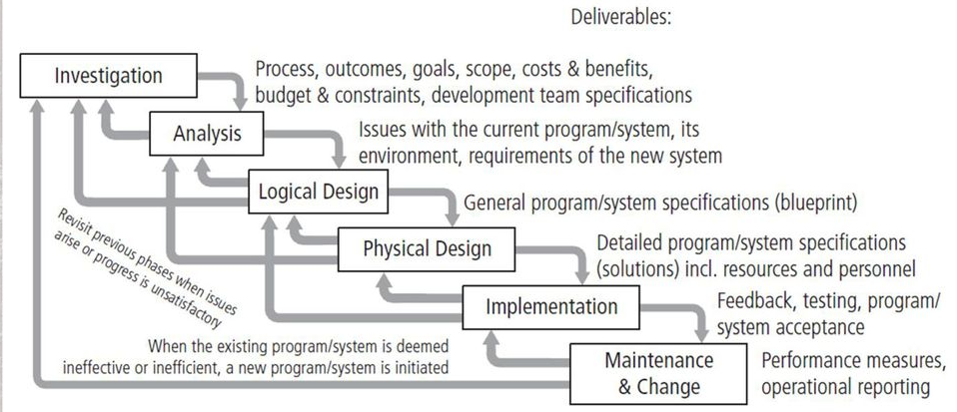
The Security Systems Development Life Cycle (SecSDLC)
Notes:
The Security Systems Development Life Cycle
The same phases used in the traditional SDLC can be adapted to support the specialized implementation of a security project.
The fundamental process is the identification of specific threats and the creation of specific controls to counter those threats.
The SecSDLC unifies the process and makes it a coherent program rather than a series of random, seemingly unconnected actions.

Slide 77
SecSDLC - Investigation
Often begins as directive from management specifying the process, outcomes, and goals of the project and its budget
Frequently begins with the affirmation or creation of security policies
Teams assembled to analyze problems, define scope, specify goals and identify constraints
A feasibility analysis determines whether the organization has the resources and commitment to conduct a successful security analysis and design
Notes:
Investigation
The investigation of the SecSDLC begins with a directive from upper management, dictating the process, outcomes and goals of the project, as well as the constraints placed on the activity.
Frequently, this phase begins with a statement of program security policy that outlines the implementation of security.
Teams of responsible managers, employees and contractors are organized, problems analyzed, and scope defined, including goals objectives, and constraints not covered in the program policy.
Finally, an organizational feasibility analysis is performed to determine whether the organization has the resources and commitment necessary to conduct a successful security analysis and design.

Slide 78
SecSDLC - Analysis
A preliminary analysis of existing security policies or programs is prepared along with known threats and associated controls
Includes an analysis of relevant legal issues that could affect the design of the security solution
Risk management begins in this stage
Notes:
Analysis
In the analysis phase, the documents from the investigation phase are studied.
The development team conducts a preliminary analysis of existing security policies or programs, along with documented current threats and associated controls.
This phase also includes an analysis of relevant legal issues that could impact the design of the security solution.
The risk management task - identifying, assessing and evaluating the levels of risk facing the organization, also begins in this stage.

Slide 79
SecSDLC - Design
The design phase actually consists of two distinct phases:
In the logical design phase, team members create and develop a blueprint for security, and examine and implement key policies
In the physical design phase, team members evaluate the technology needed to support the security blueprint, generate alternative solutions, and agree upon a final design
Notes:
Analysis
In the analysis phase, the documents from the investigation phase are studied.
The development team conducts a preliminary analysis of existing security policies or programs, along with documented current threats and associated controls.
This phase also includes an analysis of relevant legal issues that could impact the design of the security solution.
The risk management task - identifying, assessing and evaluating the levels of risk facing the organization, also begins in this stage.

Slide 80
SecSDLC - Design
The design phase continues with the formulation of the controls and safeguards used to protect information from attacks by threats. There are three categories of controls:
Managerial controls cover security processes that are designed by the strategic planners and executed by the security administration of the organization
Operational controls cover management functions and lower-level planning, such as disaster recovery and incident response planning (IRP), as well as address personnel security, physical security, and the protection of production inputs and outputs
Technical controls address technical approaches used to implement security in the organization and must be selected, acquired (made or bought), and integrated into the organization’s IT structure
Notes:
Analysis
In the analysis phase, the documents from the investigation phase are studied.
The development team conducts a preliminary analysis of existing security policies or programs, along with documented current threats and associated controls.
This phase also includes an analysis of relevant legal issues that could impact the design of the security solution.
The risk management task - identifying, assessing and evaluating the levels of risk facing the organization, also begins in this stage.

Slide 81
SecSDLC - Implementation
The security solutions are acquired, tested, implemented, and tested again
Personnel issues are evaluated and specific training and education programs conducted
Perhaps the most important element of the implementation phase is the management of the project plan:
Planning the project
Supervising the tasks and action steps within the project
Wrapping up the project
Notes:
Analysis
In the analysis phase, the documents from the investigation phase are studied.
The development team conducts a preliminary analysis of existing security policies or programs, along with documented current threats and associated controls.
This phase also includes an analysis of relevant legal issues that could impact the design of the security solution.
The risk management task - identifying, assessing and evaluating the levels of risk facing the organization, also begins in this stage.

Slide 82
Maintenance in the SecSDLC
Once the information security program is implemented, it must be operated, properly managed, and kept up to date by means of established procedures
If the program is not adjusting adequately to the changes in the internal or external environment, it may be necessary to begin the cycle again
Notes:
Analysis
In the analysis phase, the documents from the investigation phase are studied.
The development team conducts a preliminary analysis of existing security policies or programs, along with documented current threats and associated controls.
This phase also includes an analysis of relevant legal issues that could impact the design of the security solution.
The risk management task - identifying, assessing and evaluating the levels of risk facing the organization, also begins in this stage.

Slide 83
Maintenance Model
While a systems management model is designed to manage and operate systems, a maintenance model is intended to focus organizational effort on system maintenance:
External monitoring
Internal monitoring
Planning and risk assessment
Vulnerability assessment and remediation
Readiness and review
Vulnerability assessment
Notes:
Analysis
In the analysis phase, the documents from the investigation phase are studied.
The development team conducts a preliminary analysis of existing security policies or programs, along with documented current threats and associated controls.
This phase also includes an analysis of relevant legal issues that could impact the design of the security solution.
The risk management task - identifying, assessing and evaluating the levels of risk facing the organization, also begins in this stage.

Slide 84
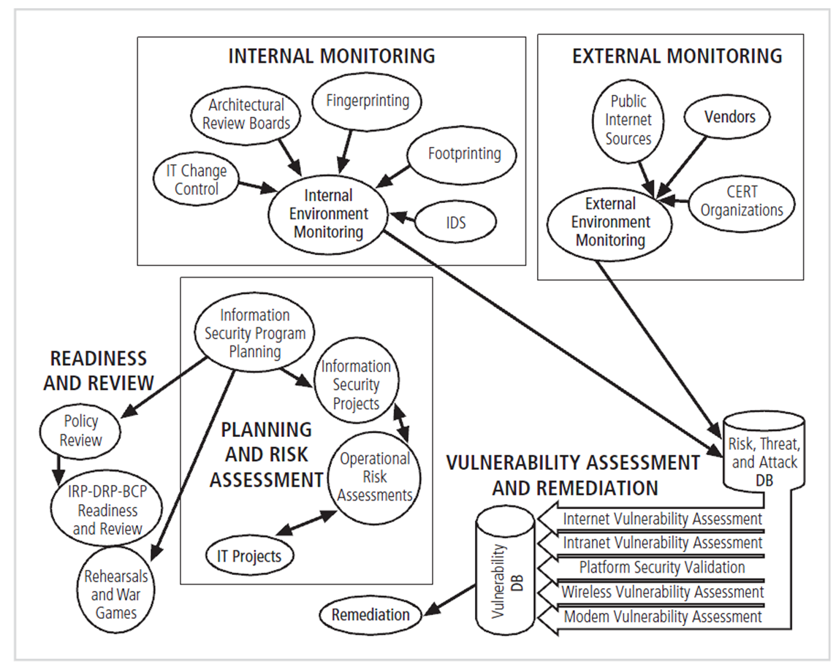
Maintenance Model
Notes:
Analysis
In the analysis phase, the documents from the investigation phase are studied.
The development team conducts a preliminary analysis of existing security policies or programs, along with documented current threats and associated controls.
This phase also includes an analysis of relevant legal issues that could impact the design of the security solution.
The risk management task - identifying, assessing and evaluating the levels of risk facing the organization, also begins in this stage.

Slide 85
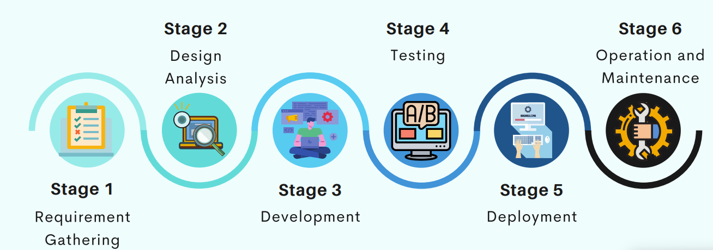
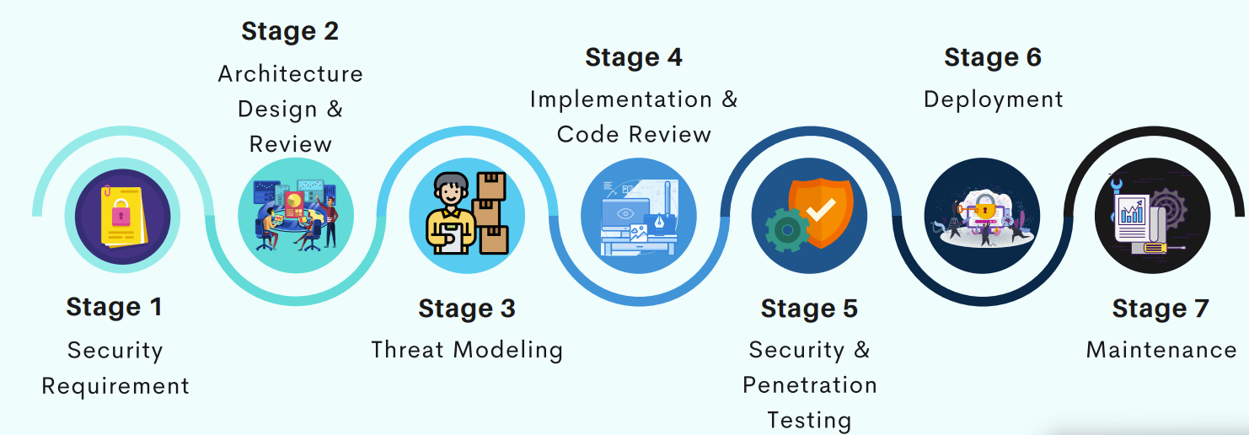
SDLC vs SSDLC
Notes:
Very much a traditional SDLC diagram.

Slide 86
Software Assurance (1 of 3)
Many organizations recognize the need to include planning for security objectives in the SDLC used to create systems.
Established procedures to create software that is more capable of being deployed in a secure fashion
This approach is known as software assurance (SA).
A national effort is under way to create a common body of knowledge focused on secure software development.
Notes:
Many organizations recognize need to include planning for security objectives in the SDLC used to create systems
Established procedures to create software more capable of being deployed in a secure fashion
This approach known as software assurance (SA)
Software Assurance Initiative resulted in publication of Secure Software Assurance (SwA) Common Body of Knowledge (CBK)

Slide 87
Software Assurance (2 of 3)
U.S. Department of Defense and Department of Homeland Security supported the Software Assurance Initiative, which resulted in the publication of Secure Software Assurance (SwA) Common Body of Knowledge (CBK).
SwA CBK serves as a strongly recommended guide to developing more secure applications.
SwA CBK, which is a work in progress, contains the following sections:
Nature of Dangers
Fundamental Concepts and Principles
Ethics, Law, and Governance
Notes:
SwA CBK is a work in progress, contains following sections:
Nature of Dangers
Fundamental Concepts and Principles
Ethics, Law, and Governance
Secure Software Requirements
Secure Software Design
Secure Software Construction
Secure Software Verification, Validation, and Evaluation
Secure Software Tools and Methods
Secure Software Processes
Secure Software Project Management
Acquisition of Secure Software
Secure Software Sustainment

Slide 88
Software Assurance (3 of 3)
Secure Software Requirements
Secure Software Design
Secure Software Construction
Secure Software Verification, Validation, and Evaluation
Secure Software Tools and Methods
Secure Software Processes
Secure Software Project Management
Acquisition of Secure Software
Secure Software Sustainment

Slide 89
Software Design Principles (1 of 2)
Good software development results in secure products that meet all design specifications.
Some commonplace security principles
Keep design simple and small
Access decisions by permission not exclusion
Every access to every object checked for authority
Design depends on possession of keys/passwords
Protection mechanisms require two keys to unlock
Programs/users utilize only necessary privileges

Slide 90
Software Design Principles (2 of 2)
Some commonplace security principles
Minimize mechanisms common to multiple users
Human interface must be easy to use so users routinely/automatically use protection mechanisms.

Slide 91
The NIST Approach to Securing the SDLC
NIST Special Publication 800-64, rev. 2, maintains that early integration of security in the SDLC enables agencies to maximize return on investment through:
Early identification and mitigation of security vulnerabilities and misconfigurations
Awareness of potential engineering challenges
Identification of shared security services and reuse of security strategies and tools
Facilitation of informed executive decision making
Notes:
The NIST Approach to Securing the SDLC
NIST Special Publication 800-64 rev. 2 maintains that early integration of security in the SDLC enables agencies to maximize return on investment through:
Early identification and mitigation of security vulnerabilities and misconfigurations
Awareness of potential engineering challenges
Identification of shared security services and reuse of security strategies and tools
Facilitation of informed executive decision making

Slide 92
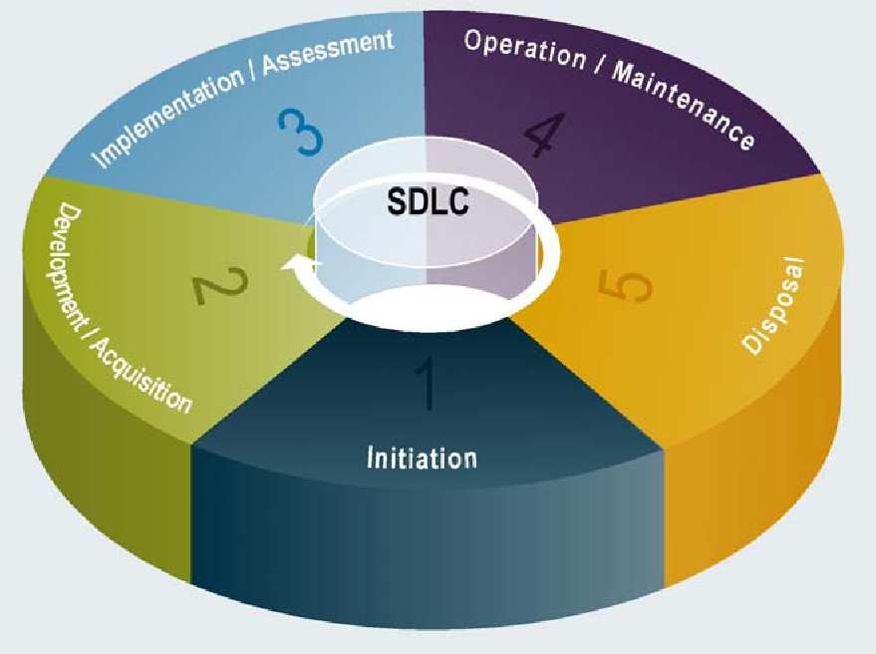
The NIST Approach
Notes:
Initiation
Security at this point looked at in terms of business risks, with information security office providing input
Key security activities include:
Delineation of business requirements in terms of confidentiality, integrity, and availability
Determination of information categorization and identification of known special handling requirements to transmit, store, or create information
Determination of any privacy requirements

Slide 93
The NIST Approach: Initiation
Security at this point is looked at in terms of business risks, with information security office providing input.
Key security activities include:
Delineation of business requirements in terms of confidentiality, integrity, and availability
Determination of information categorization and identification of known special handling requirements to transmit, store, or create information
Determination of any privacy requirements
Notes:
Initiation
Security at this point looked at in terms of business risks, with information security office providing input
Key security activities include:
Delineation of business requirements in terms of confidentiality, integrity, and availability
Determination of information categorization and identification of known special handling requirements to transmit, store, or create information
Determination of any privacy requirements

Slide 94
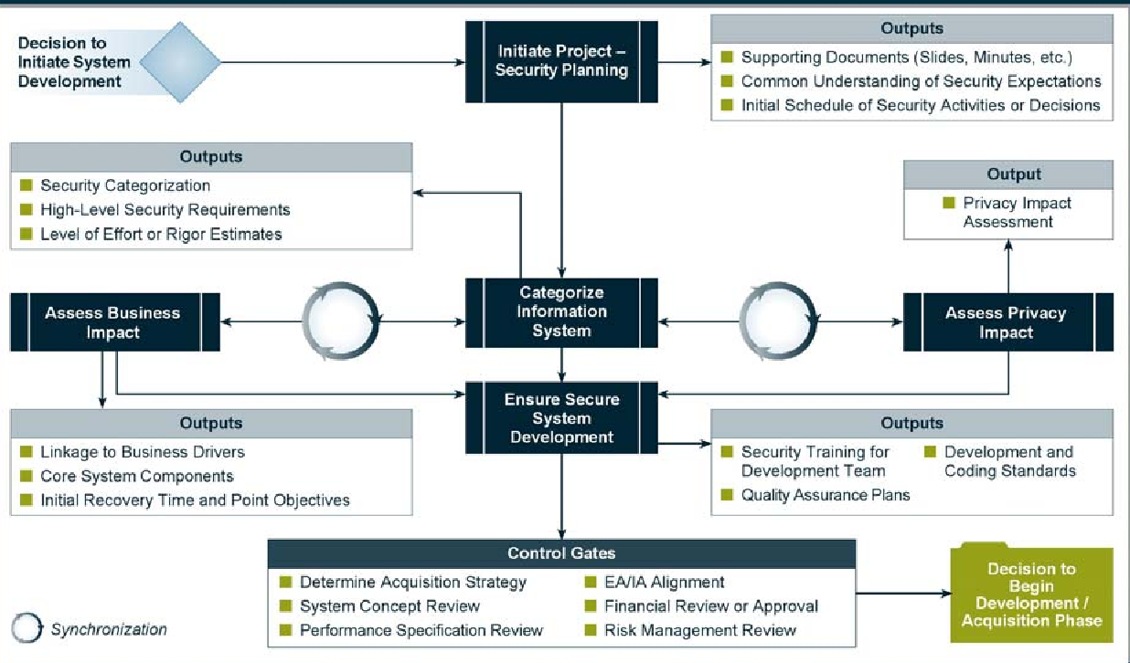
The NIST Approach: Initiation
Notes:
Initiation
Security at this point looked at in terms of business risks, with information security office providing input
Key security activities include:
Delineation of business requirements in terms of confidentiality, integrity, and availability
Determination of information categorization and identification of known special handling requirements to transmit, store, or create information
Determination of any privacy requirements

Slide 95
The NIST Approach: Development/Acquisition
Key security activities include:
Conducting risk assessment and using results to supplement baseline security controls
Analyzing security requirements
Performing functional and security testing
Preparing initial documents for system certification and accreditation
Designing security architecture
Notes:
Development/Acquisition
Key security activities include:
Conduct risk assessment and use results to supplement baseline security controls
Analyze security requirements
Perform functional and security testing
Prepare initial documents for system certification and accreditation
Design security architecture

Slide 96
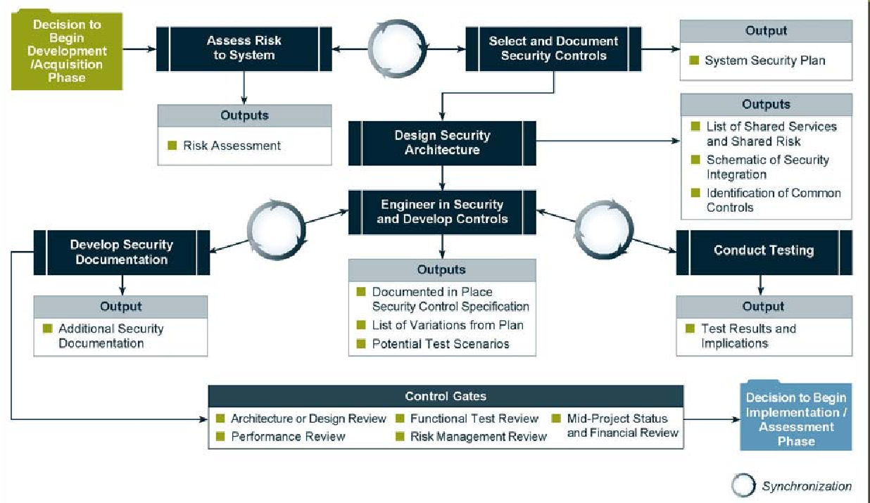
The NIST Approach: Development/Acquisition
Notes:
Development/Acquisition
Key security activities include:
Conduct risk assessment and use results to supplement baseline security controls
Analyze security requirements
Perform functional and security testing
Prepare initial documents for system certification and accreditation
Design security architecture

Slide 97
The NIST Approach: Implementation/Assessment
System is installed and evaluated in operational environment.
Key security activities include:
Integrating information system into its environment
Planning and conducting system certification activities in synchronization with testing of security controls
Completing system accreditation activities
Notes:
Implementation/Assessment
System installed and evaluated in operational environment
Key security activities include:
Integrate information system into its environment
Plan and conduct system certification activities in synchronization with testing of security controls
Complete system accreditation activities

Slide 98
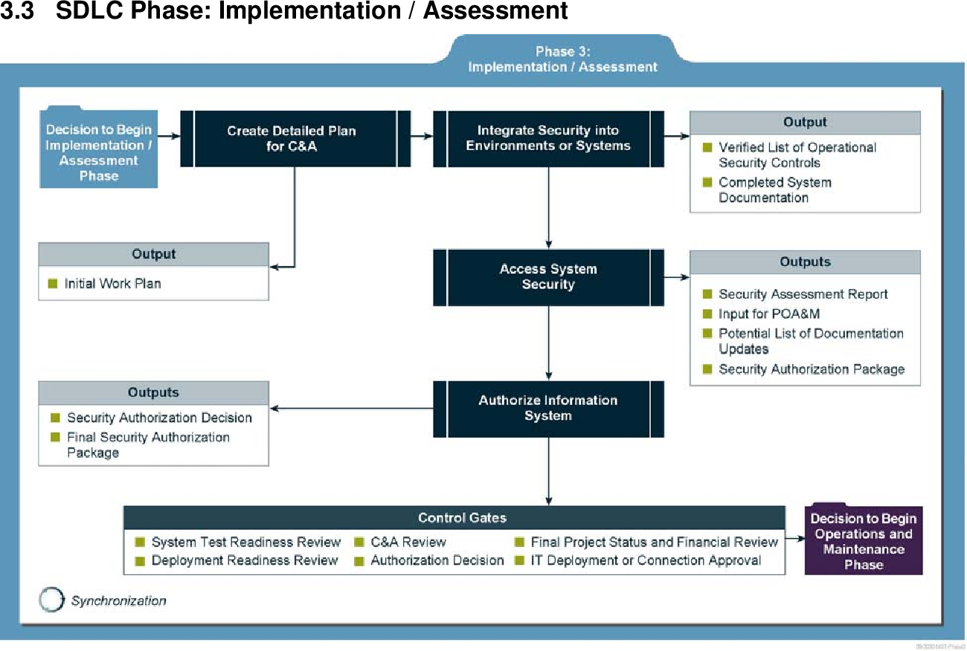
The NIST Approach: Implementation/Assessment
Notes:
Implementation/Assessment
System installed and evaluated in operational environment
Key security activities include:
Integrate information system into its environment
Plan and conduct system certification activities in synchronization with testing of security controls
Complete system accreditation activities

Slide 99
The NIST Approach: Operations and Maintenance
Systems are in place and operating, enhancements and/or modifications to the system are developed and tested, and hardware and/or software are added or replaced.
Key security activities include:
Conducting operational readiness review
Managing configuration of system
Instituting process and procedure for assured operations and continuous monitoring of information system’s security controls
Performing reauthorization as required
Notes:
Operations and Maintenance:
Systems are in place and operating, enhancements and/or modifications to the system are developed and tested, and hardware and/or software added or replaced
Key security activities include:
Conduct operational readiness review
Manage configuration of system
Institute process and procedure for assured operations and continuous monitoring of information system’s security controls
Perform reauthorization as required

Slide 100
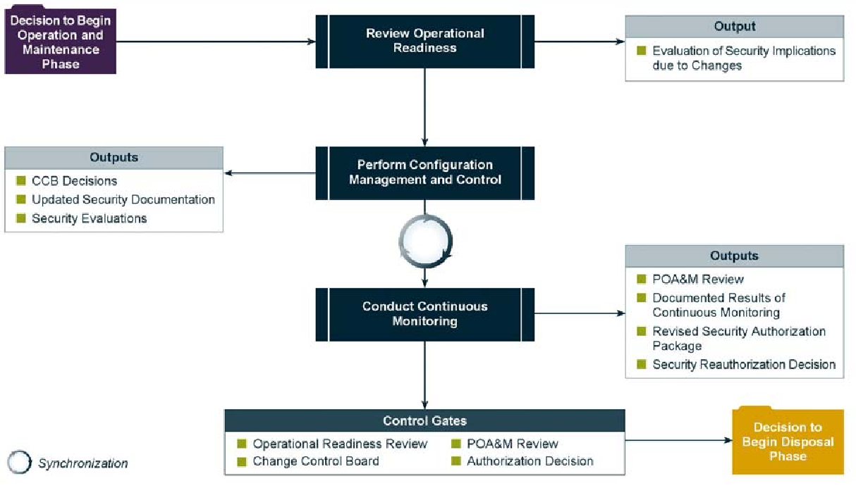
The NIST Approach: Operations and Maintenance
Notes:
Operations and Maintenance:
Systems are in place and operating, enhancements and/or modifications to the system are developed and tested, and hardware and/or software added or replaced
Key security activities include:
Conduct operational readiness review
Manage configuration of system
Institute process and procedure for assured operations and continuous monitoring of information system’s security controls
Perform reauthorization as required

Slide 101
The NIST Approach: Disposal
Provides for disposal of system and closeout of any contracts in place
Key security activities include:
Building and executing disposal/transition plan
Archival of critical information
Sanitization of media
Disposal of hardware and software
Notes:
Disposal:
Provides for disposal of system and closeout of any contracts in place
Key security activities include:
Building and executing disposal/transition plan
Archival of critical information
Sanitization of media
Disposal of hardware and software

Slide 102
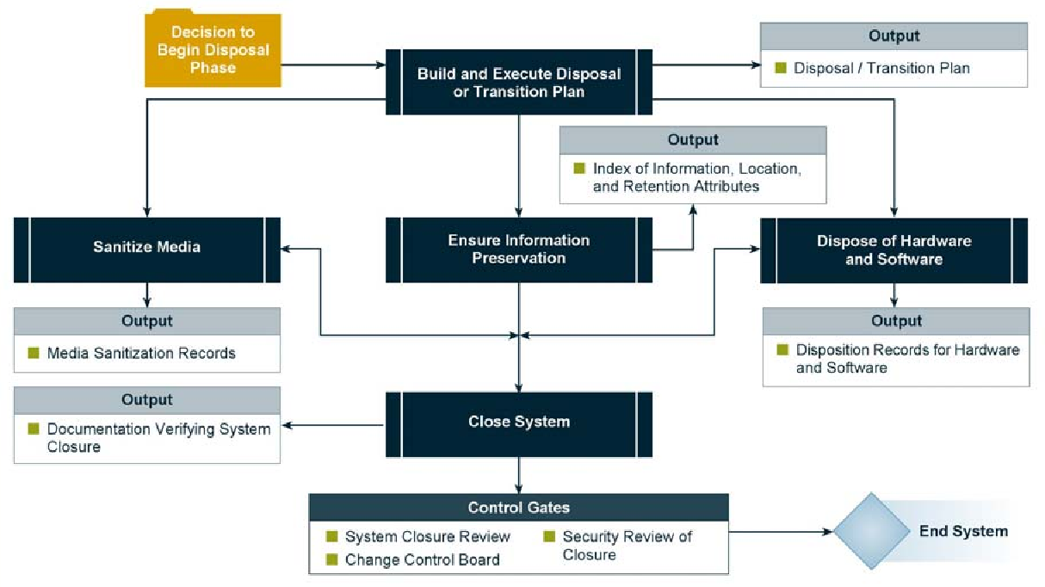
The NIST Approach: Disposal
Notes:
Disposal:
Provides for disposal of system and closeout of any contracts in place
Key security activities include:
Building and executing disposal/transition plan
Archival of critical information
Sanitization of media
Disposal of hardware and software

Slide 103
Communities of Interest
Group of individuals united by similar interests/values within an organization
Information security management and professionals
Information technology management and professionals
Organizational management and professionals
Notes:
Communities of Interest
Each organization develops and maintains its own unique culture and values. Within that corporate culture, there are communities of interest. These include:
Information Security Management and Professionals
Information Technology Management and Professionals
Organizational Management and Professionals

Slide 104
Security Professionals and the Organization
Wide range of professionals are required to support a diverse information security program.
Senior management is the key component.
Additional administrative support and technical expertise are required to implement details of the IS program.
Notes:
Security Professionals and the Organization
It takes a wide range of professionals to support a diverse information security program.
To develop and execute specific security policies and procedures, additional administrative support and technical expertise is required.

Slide 105
Staffing the InfoSec Function
Each organization should examine the options for staffing of the information security function:
First, decide how to position and name the security function
Second, plan for the proper staffing of the information security function
Third, understand the impact of information security across every role in IT
Finally, integrate solid information security concepts into the personnel management practices of the organization
Notes:
Analysis
In the analysis phase, the documents from the investigation phase are studied.
The development team conducts a preliminary analysis of existing security policies or programs, along with documented current threats and associated controls.
This phase also includes an analysis of relevant legal issues that could impact the design of the security solution.
The risk management task - identifying, assessing and evaluating the levels of risk facing the organization, also begins in this stage.

Slide 106
Senior Management
Chief information officer (CIO)‏
Senior technology officer
Primarily responsible for advising the senior executives on strategic planning
Chief information security officer (CISO)‏
Has primary responsibility for assessment, management, and implementation of IS in the organization
Usually reports directly to the CIO
Notes:
Senior Management
Chief Information Officer – The senior technology officer, although other titles such as Vice President of Information, VP of Information Technology, and VP of Systems may be used. The CIO is primarily responsible for advising the Chief Executive Officer, President, or company owner on the strategic planning that affects the management of information in the organization.
Chief Information Security Officer – The individual primarily responsible for the assessment, management, and implementation of securing the information in the organization. The CISO may also be referred to as the Manager for Security, the Security Administrator, or a similar title.

Slide 107
Information Security Project Team
A small functional team of people who are experienced in one or multiple facets of required technical and nontechnical areas:
Champion
Team leader
Security policy developers
Risk assessment specialists
Security professionals
Systems administrators
End users
Notes:
Security Project Team
A number of individuals who are experienced in one or multiple requirements of both the technical and nontechnical areas.
The champion: A senior executive who promotes the project and ensures its support, both financially and administratively, at the highest levels of the organization.
The team leader: A project manager, who may be a departmental line manager or staff unit manager, who understands project management, personnel management, and information security technical requirements.
Security policy developers: Individuals who understand the organizational culture, policies, and requirements for developing and implementing successful policies.
Risk assessment specialists: People who understand financial risk assessment techniques, the value of organizational assets, and the security methods to be used.
Security professionals: Dedicated, trained, and well-educated specialists in all aspects of information security from both technical and nontechnical standpoints.
Systems administrators: People with the primary responsibility for administering the systems that house the information used by the organization.
End users: Those whom the new system will most directly impact. Ideally, a selection of users from various departments, levels, and degrees of technical knowledge assist the team in focusing on the application of realistic controls applied in ways that do not disrupt the essential business activities they seek to safeguard.

Slide 108
Data Responsibilities
Data owners: senior management responsible for the security and use of a particular set of information
Data custodians: responsible for the information and systems that process, transmit, and store it
Data users: individuals with an information security role
Notes:
Data Responsibilities
Data owners: Members of senior management who are responsible for the security and use of a particular set of information. The data owners usually determine the level of data classification (discussed later), as well as the changes to that classification required by organizational change. The data owners work with subordinate managers to oversee the day-to-day administration of the data.
● Data custodians: Working directly with data owners, data custodians are responsible for the information and the systems that process, transmit, and store it. Depending on the size of the organization, this may be a dedicated position, such as the CISO, or it may be an additional responsibility of a systems administrator or other technology manager. The duties of a data custodian often include overseeing data storage and backups, implementing the specific procedures and policies laid out in the security policies and plans, and reporting to the data owner.
● Data users: Everyone in the organization is responsible for the security of data, so data users are included here as individuals with an information security role.

Slide 109
Information Security: Is It an Art or a Science?
Implementation of information security is often described as a combination of art and science.
“Security artisan” idea: based on the way individuals perceive system technologists and their abilities.
Notes:
Information Security: Is It an Art or a Science?
With the level of complexity in today’s information systems, the implementation of information security has often been described as a combination of art and science.
The concept of the security artisan is based on the way individuals perceived systems technologists since computers became commonplace.

Slide 110
Security as Art
No hard and fast rules nor many universally accepted complete solutions
No manual for implementing security through entire system
Notes:
Security as Art
There are no hard and fast rules regulating the installation of various security mechanisms.
Nor are there many universally accepted complete solutions.
While there are many manuals to support individual systems, once these systems are interconnected, there is no magic user’s manual for the security of the entire system.
This is especially true with the complex levels of interaction between users, policy, and technology controls.

Slide 111
Security as Science
Dealing with technology designed for rigorous performance levels.
Specific conditions cause virtually all actions in computer systems.
Almost every fault, security hole, and systems malfunction is a result of interaction of specific hardware and software.
If developers had sufficient time, they could resolve and eliminate faults.
Notes:
Security as Science
We are dealing with technology developed by computer scientists and engineers—technology designed to perform at rigorous levels of performance.
Even with the complexity of the technology, most scientists would agree that specific scientific conditions cause virtually all actions that occur in computer systems.
Almost every fault, security hole, and systems malfunction is a result of the interaction of specific hardware and software.
If the developers had sufficient time, they could resolve and eliminate these faults.

Slide 112
Security as a Social Science
Social science examines the behavior of individuals interacting with systems.
Security begins and ends with the people that interact with the system, intentionally or otherwise.
Security administrators can greatly reduce the levels of risk caused by end users and create more acceptable and supportable security profiles.
Notes:
Security as a Social Science
There is a third view: security as a social science.
Social science examines the behavior of individuals as they interact with systems, whether societal systems or in our case information systems.
Security begins and ends with the people inside the organization and the people that interact with the system planned or otherwise.
End users that need the very information the security personnel are trying to protect may be the weakest link in the security chain.
By understanding some of the behavioral aspects of organizational science and change management, security administrators can greatly reduce the levels of risk caused by end users and create more acceptable and supportable security profiles.

Slide 113
Scenario Questions to be Practiced
A law enforcement agency needs to protect sensitive investigation data in use. Which information state and characteristic is relevant, and what countermeasures could be implemented to address this concern?
Information state: In use
Information characteristic: Confidentiality, integrity
Countermeasures:
Implement access controls to ensure only authorized individuals can access the data
Use encryption to protect the confidentiality of the data while in use
Implement auditing and monitoring to detect unauthorized access or modification
Notes:
Security as a Social Science
There is a third view: security as a social science.
Social science examines the behavior of individuals as they interact with systems, whether societal systems or in our case information systems.
Security begins and ends with the people inside the organization and the people that interact with the system planned or otherwise.
End users that need the very information the security personnel are trying to protect may be the weakest link in the security chain.
By understanding some of the behavioral aspects of organizational science and change management, security administrators can greatly reduce the levels of risk caused by end users and create more acceptable and supportable security profiles.

